Slide 1
CS7IS2 Artificial Intelligence
mankadp@tcd.ie - 18313732
jeevasag@tcd.ie -18303806
ghoshso@tcd.ie -19317919
goelaa@tcd.ie - 19308546
chavadyg@tcd.ie - 19305272

Slide 2
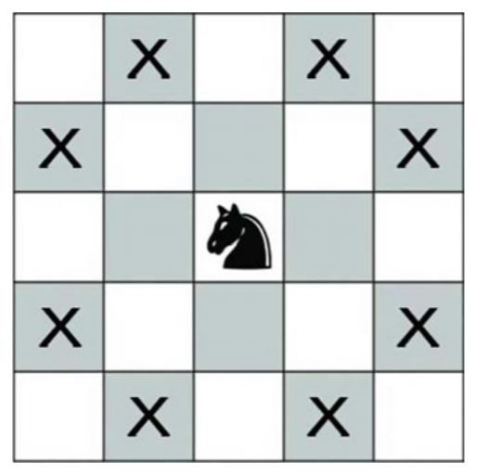
Knight’s Tour Problem
8 possible Knight moves
Traverse all squares from a random position
Return to start position after visiting every square once
Two type of tours
-open tour (uses Hamiltonian path)
-closed tour (uses Hamiltonian circuit)
L shaped moves
Selected possible moves
(2, 1), (1, 2), (-1, 2), (-2, 1), (-2, -1), (-1, -2), (1, -2), (2, -1).

Slide 3
Algorithms Chosen
Traditional Approaches
Depth First Search
Recursive Backtracking
Warnsdorff’s
Novel Approaches
Neural Networks
Ant Colony Optimization

Slide 4
Observations
compared the performance of algorithms on 8 x 8 chess board.
Our novel approaches perform well
Depth first search
old off the shelve approach with large time and space complexity
Warnsdorff’s Algorithm
non deterministic and unreliable
Backtracking
slower and lead to dead ends
Neural network solution
faster computation and also suitable for larger sized boards
Ant colony optimization
single ant colony converge to one path and may lead to dead end
multiple ant colony lead to multiple optimum paths

Slide 5
Thank You!

